Slide 1
hr analytics
Project Objective:
There is an ever-increasing focus on effective recruitment. An organization invests a lot of its time and resources in search of the potential candidates. The investment become loses if the selected candidates do not join the organization in the end.
Created By:
Prathamesh P Bait
Maneesha Bisht
Gunjan Sarkar
Shruti Sharma

Slide 2
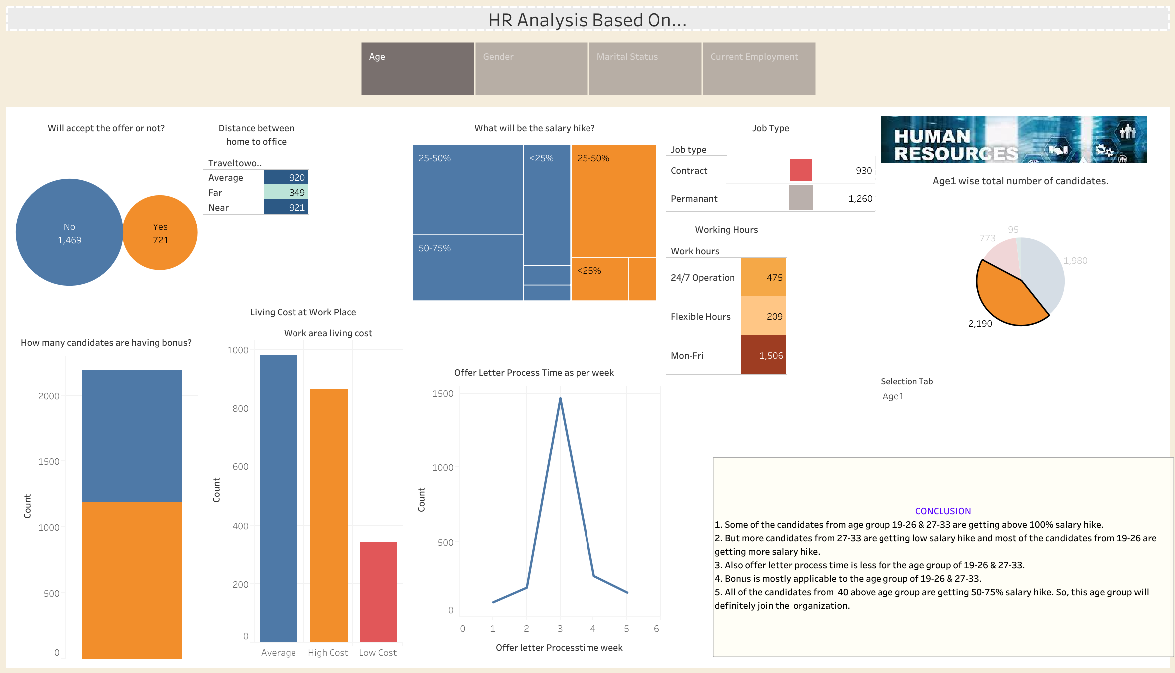

Slide 3
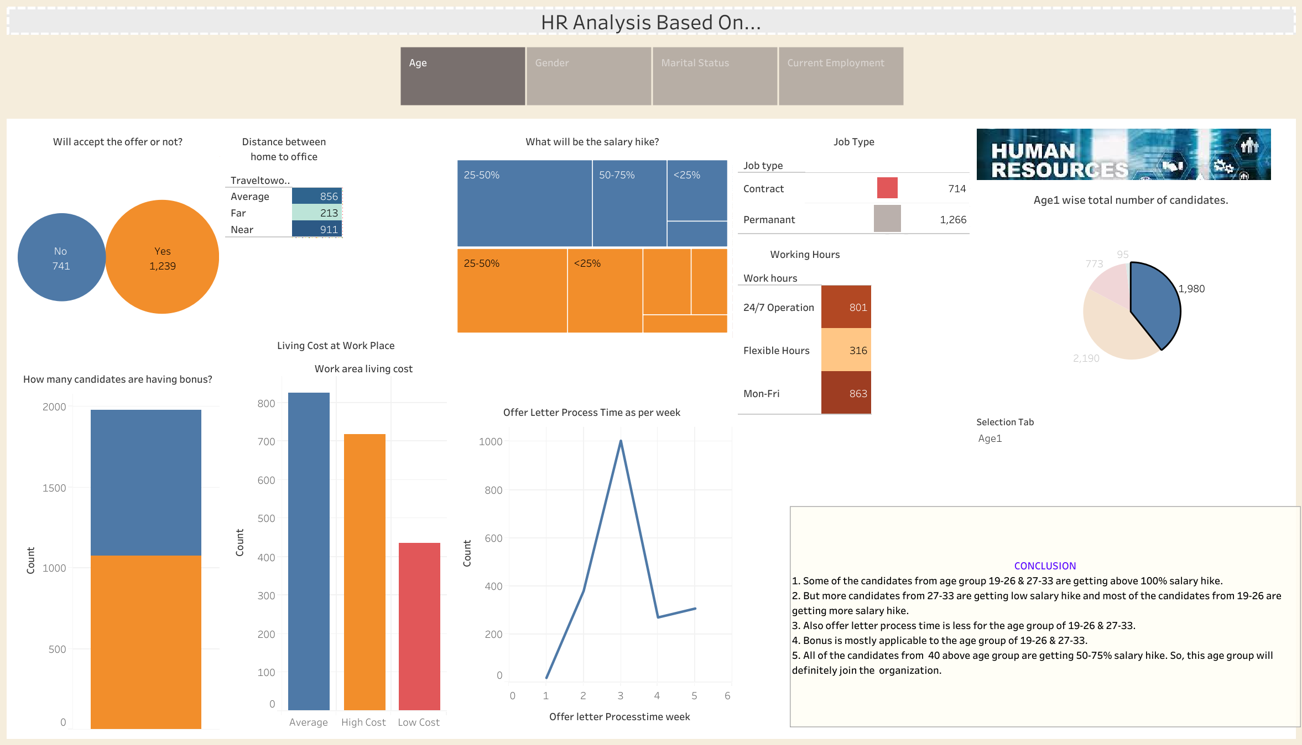

Slide 4
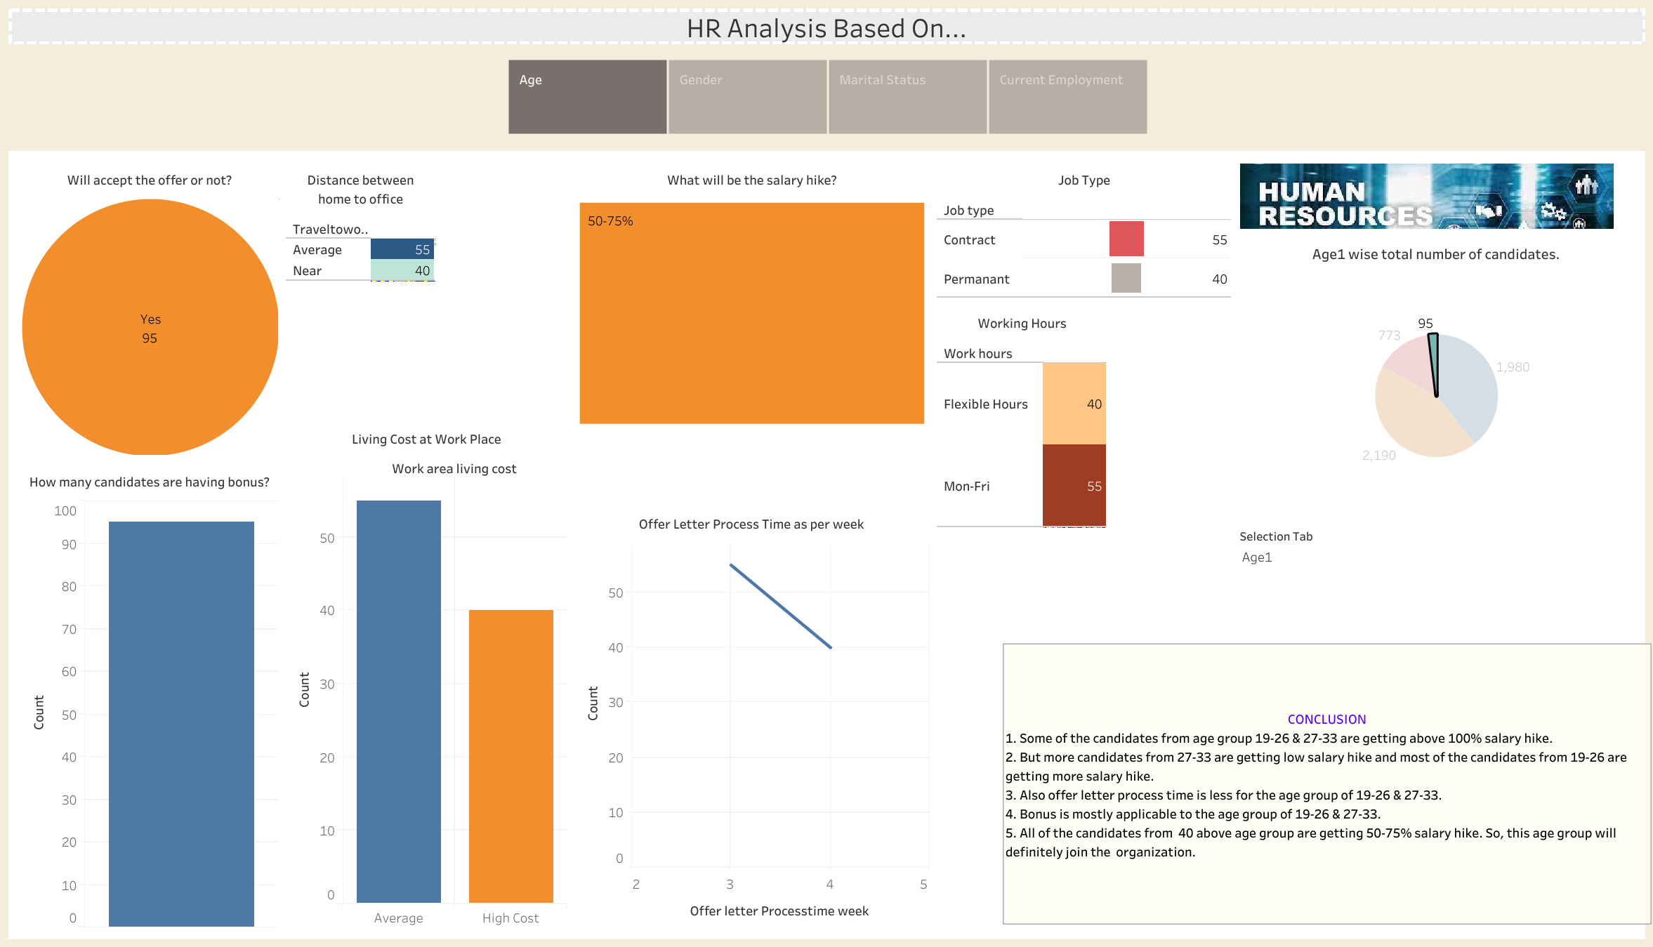

Slide 5
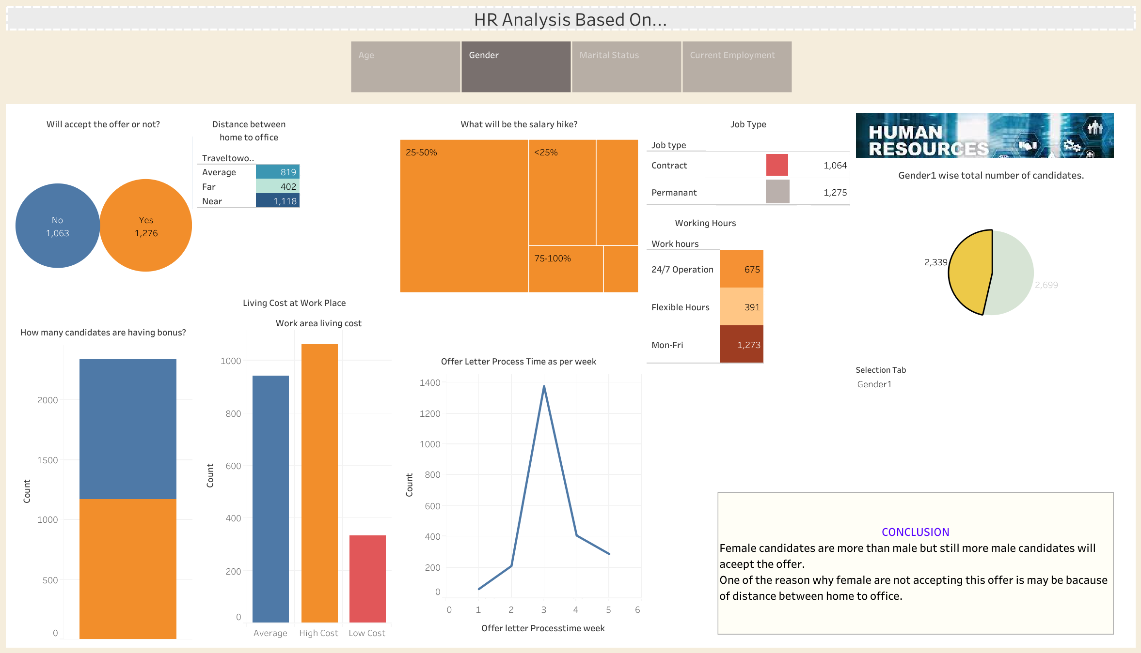

Slide 6
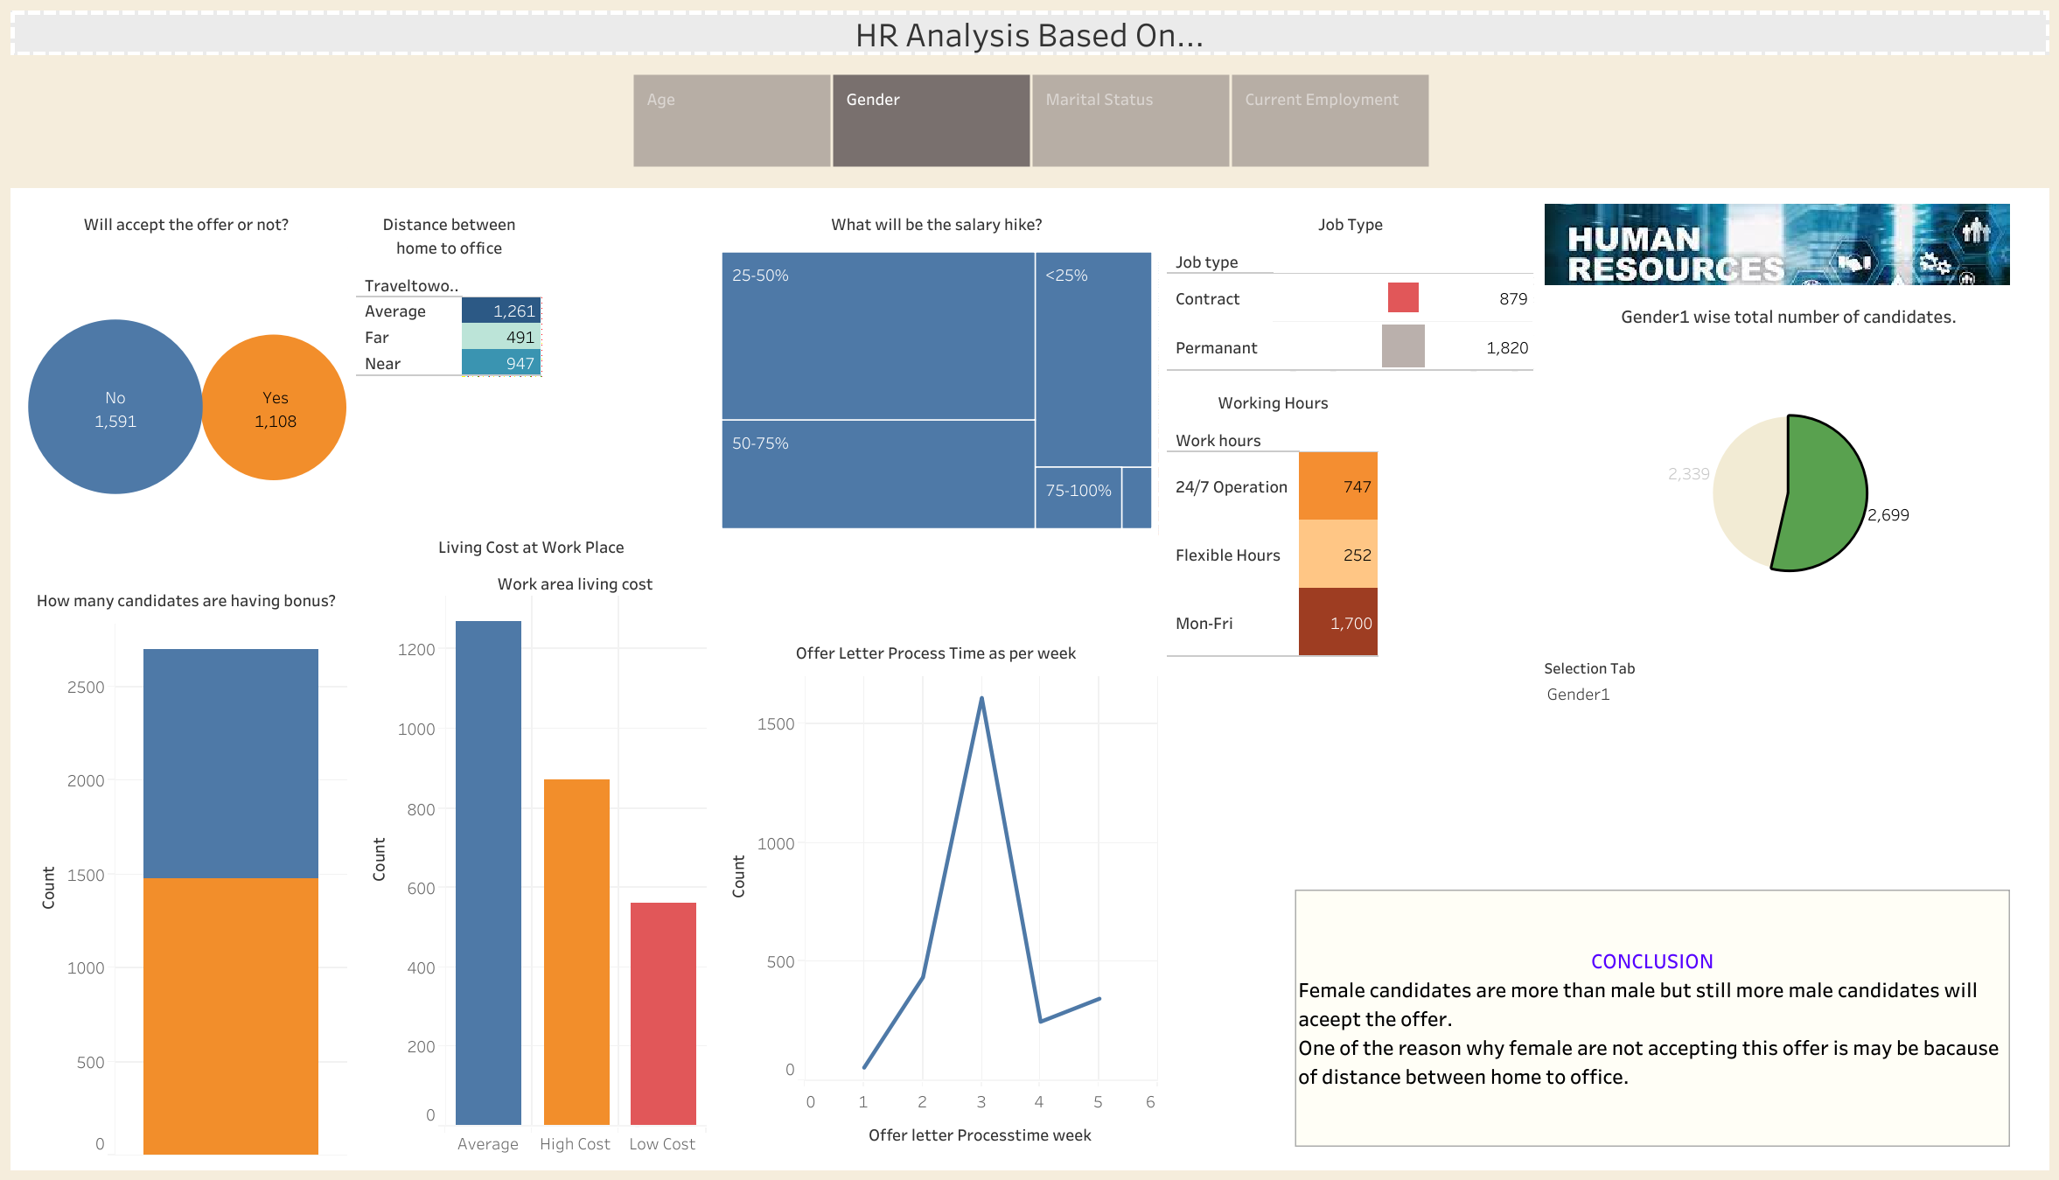

Slide 7
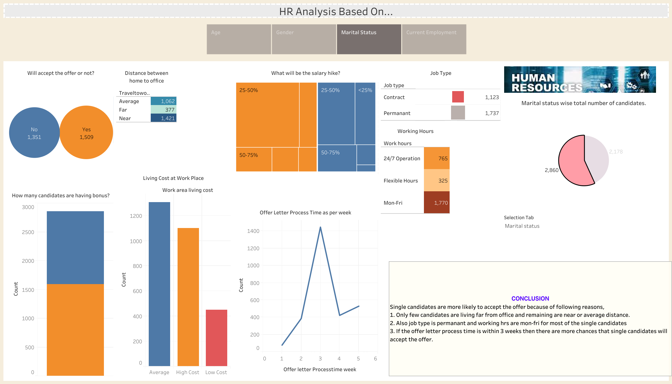

Slide 8
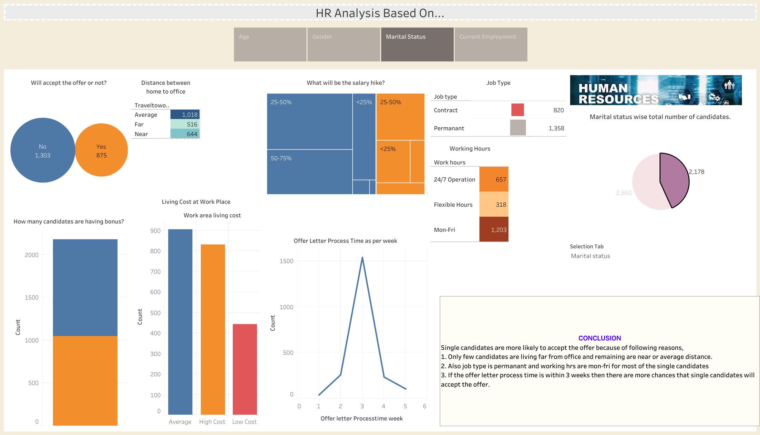

Slide 9
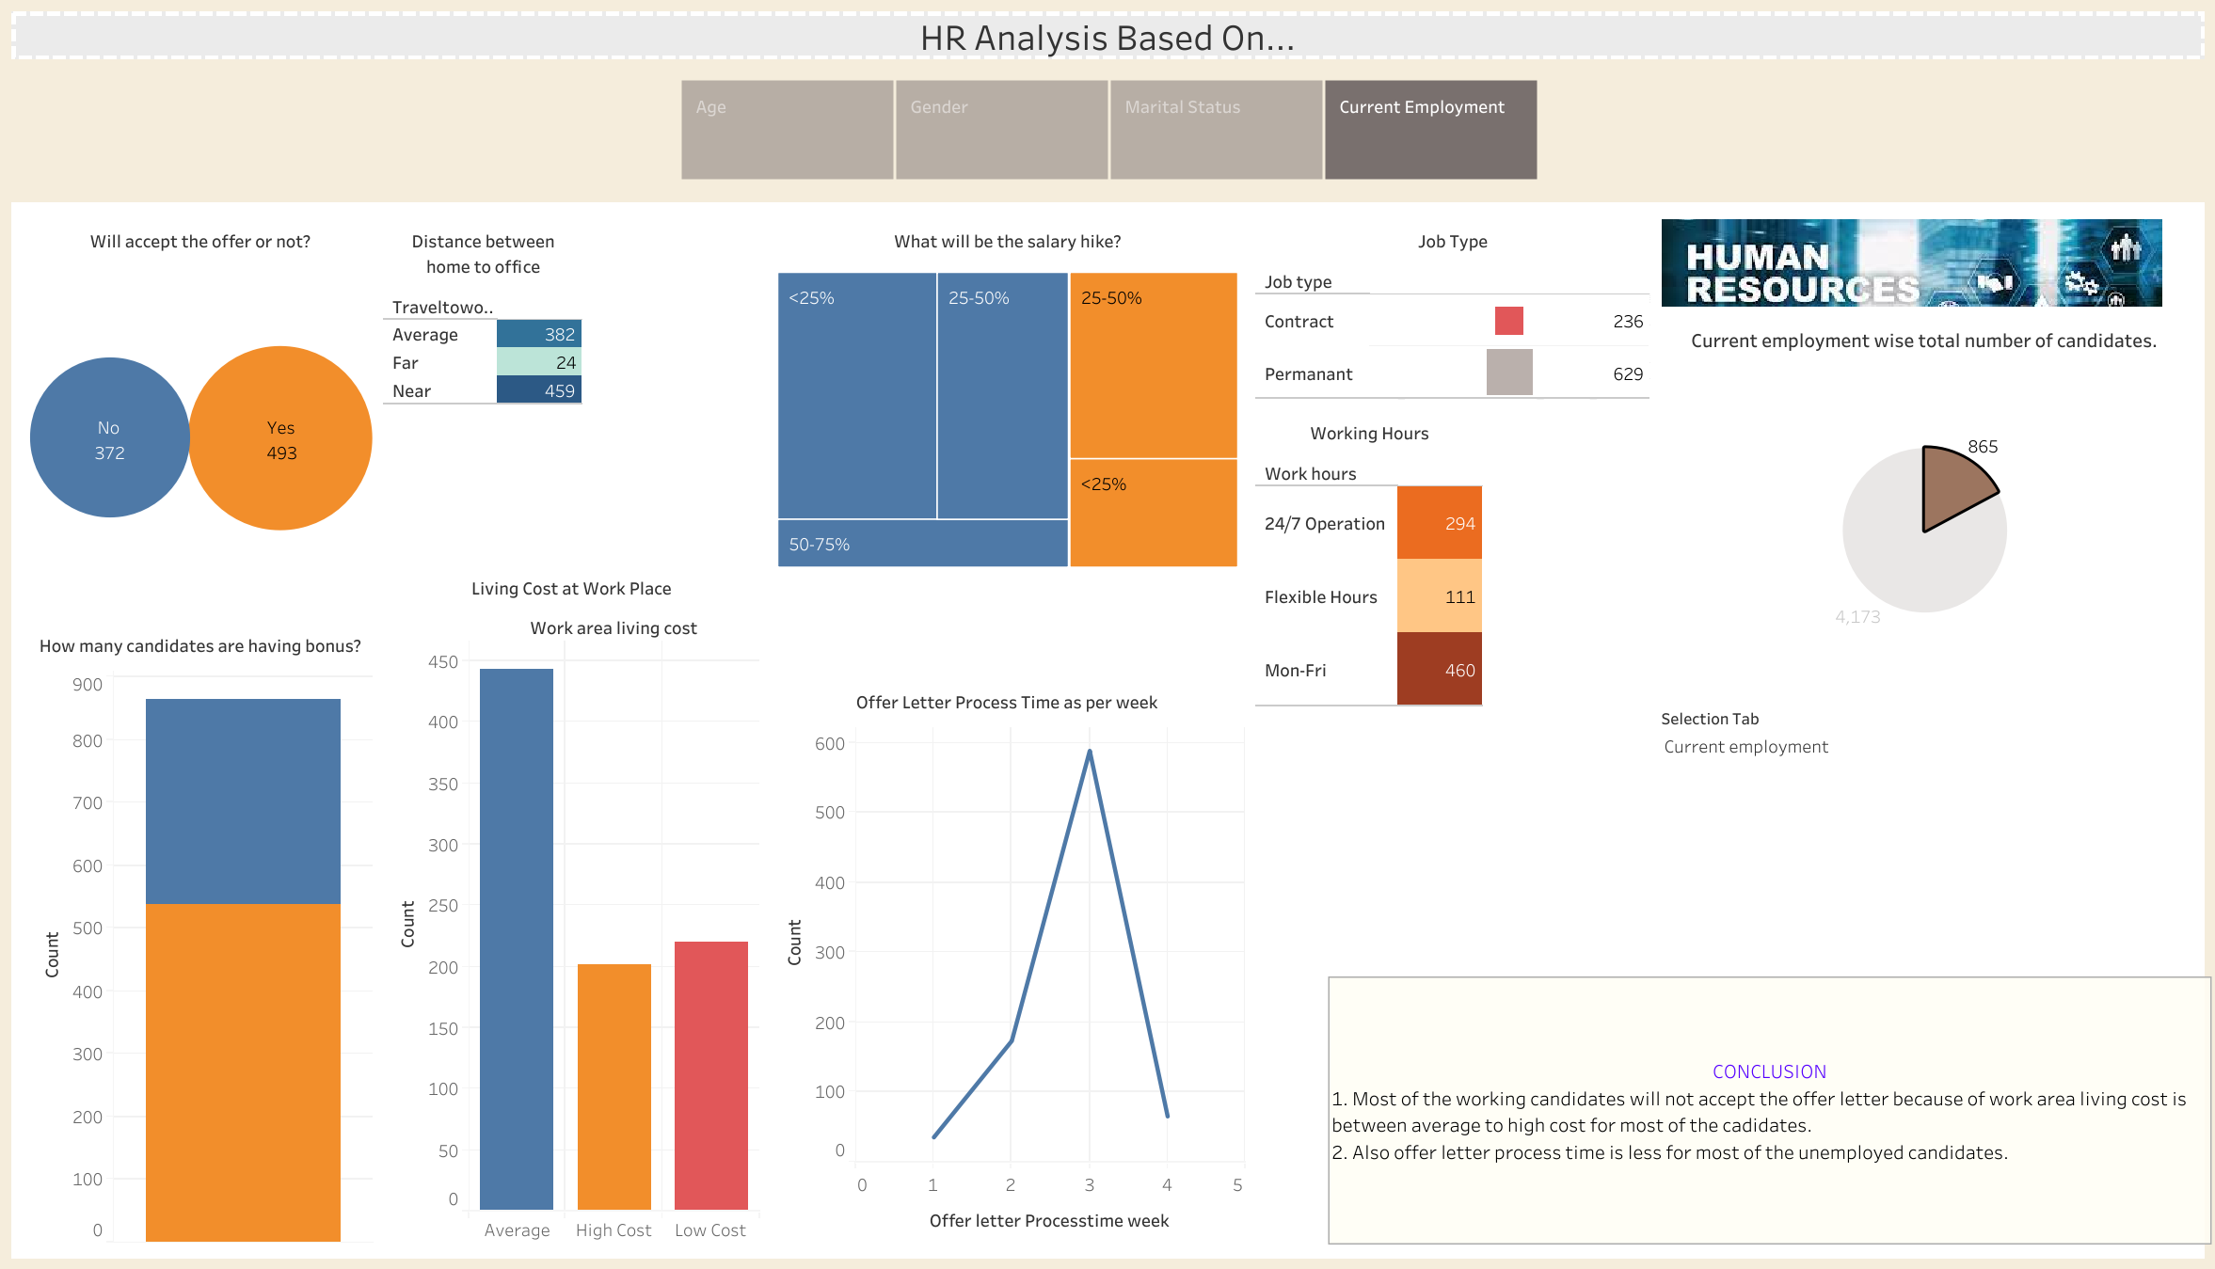

Slide 10
